Slide 1

Data Mining-IS252.N22.HTCL
Final Project Report
CHICAGO CRIME ANALYSIS
Do Thanh Truong -20522079
Nguyen Thi Trang Tho -20521973
Le Ngoc Mai Thanh -20521913
Trinh Duong Ngoc Tran -20522036

Slide 2

Table of contents:
01. Introduction
02. Data Pre-processing
03. Data Modeling
04. Applying Algorithms
05. Conclusion

Slide 3

01. Introduction
a/ Dataset description
b/ Problem Statement and Tools
Dataset in general
MORE

Slide 4
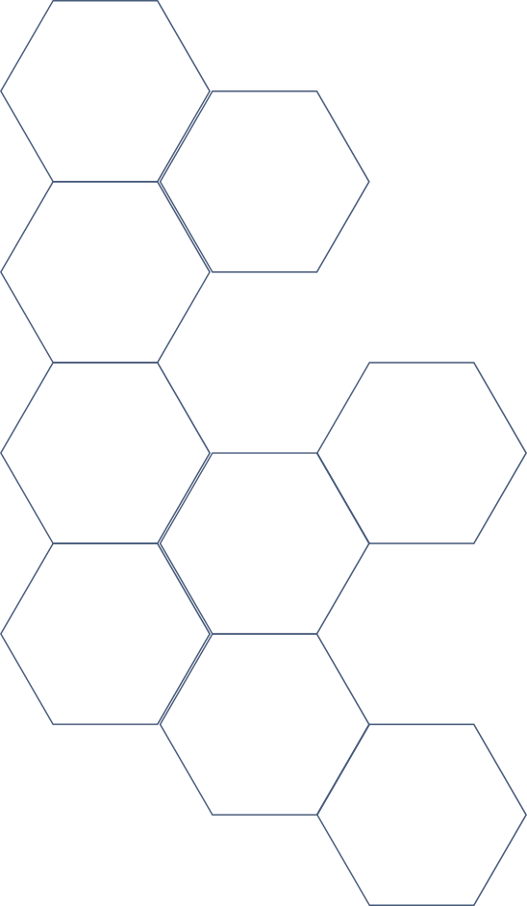

Dataset Description
Source
Kaggle
1456714
Lines of data
23
Attribute Columns

Slide 5

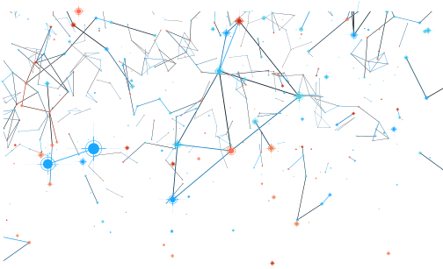
Problem Statement and Tools
Problem Statement
Based on available attributes in the dataset as well as using Machine Learning Algorithms, we determine the factors influencing the crime rate in Chicago. This may help us to classify the types of crimes in this city.
Tools
Google Colab
Jupyter Notebook

Slide 6

CHAPTER 2
DATA MODELING

Slide 7
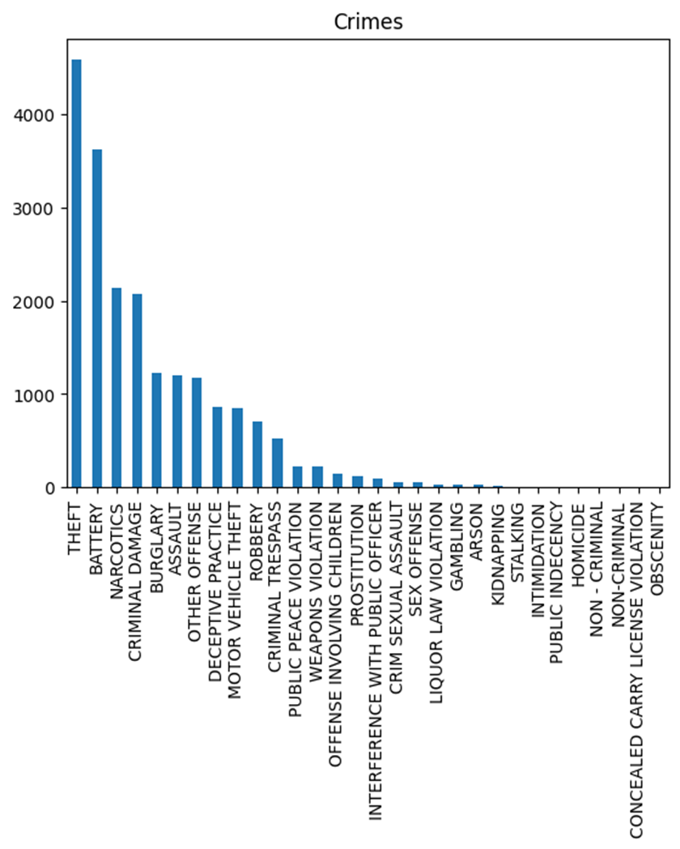


The number of crimes for each type of offense

Slide 8
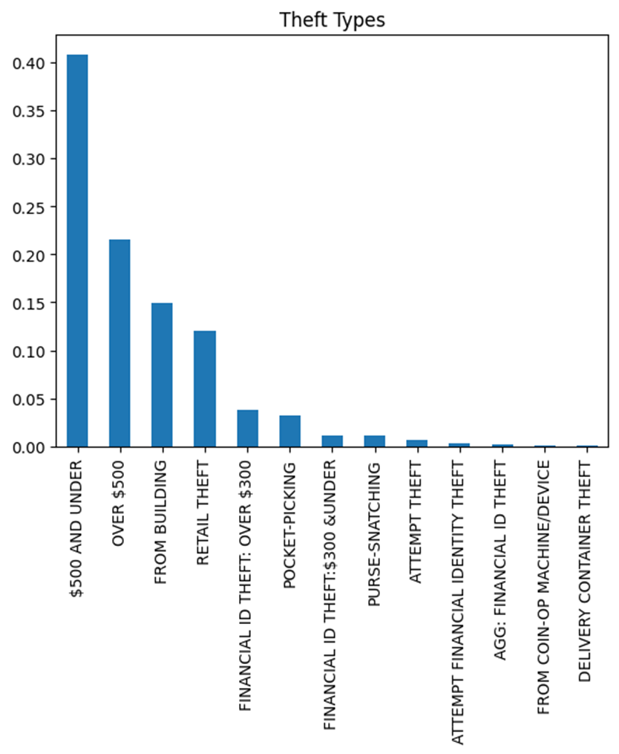

THEFT TYPES

Slide 9
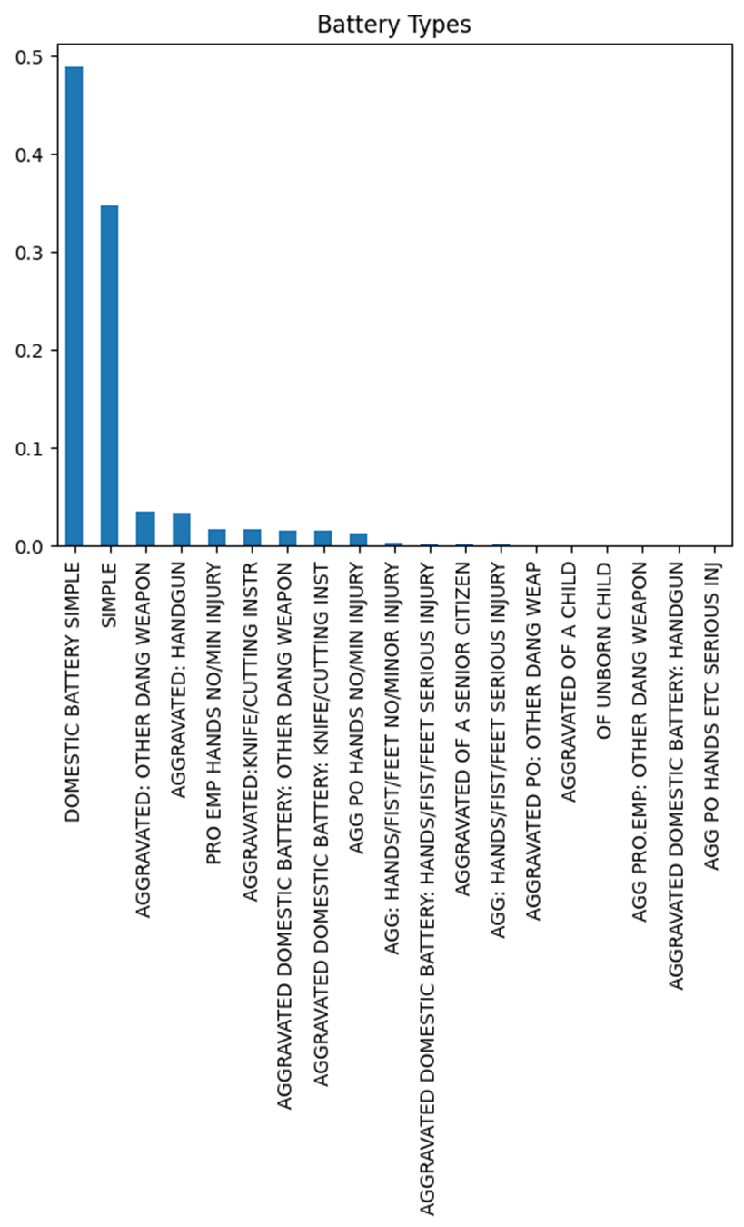
BATTERY TYPES

Slide 10
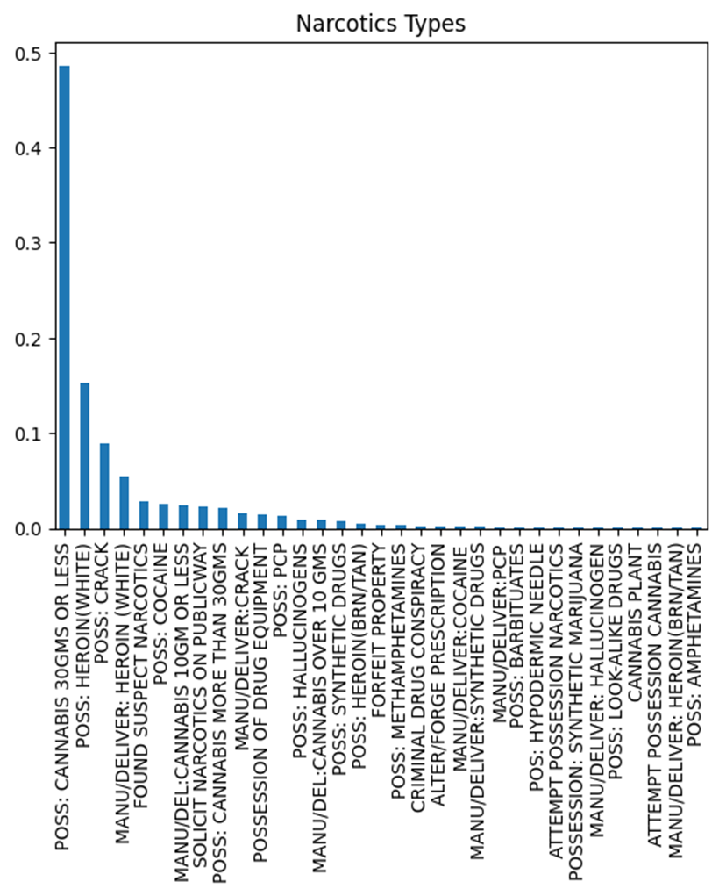
NARCOTICS TYPES

Slide 11
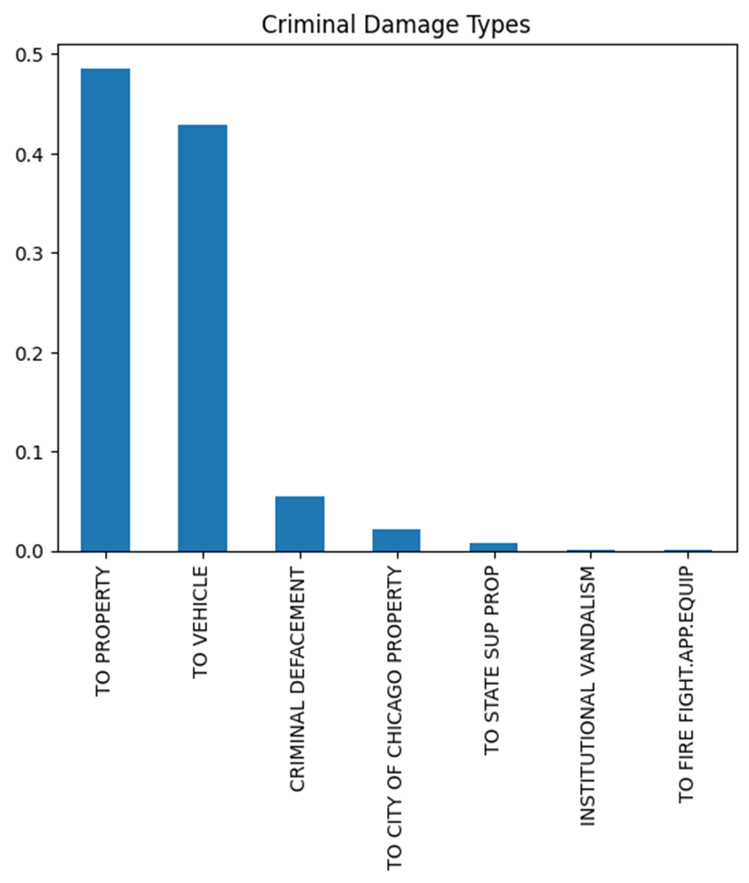
CRIMINAL DAMAGE TYPES

Slide 12
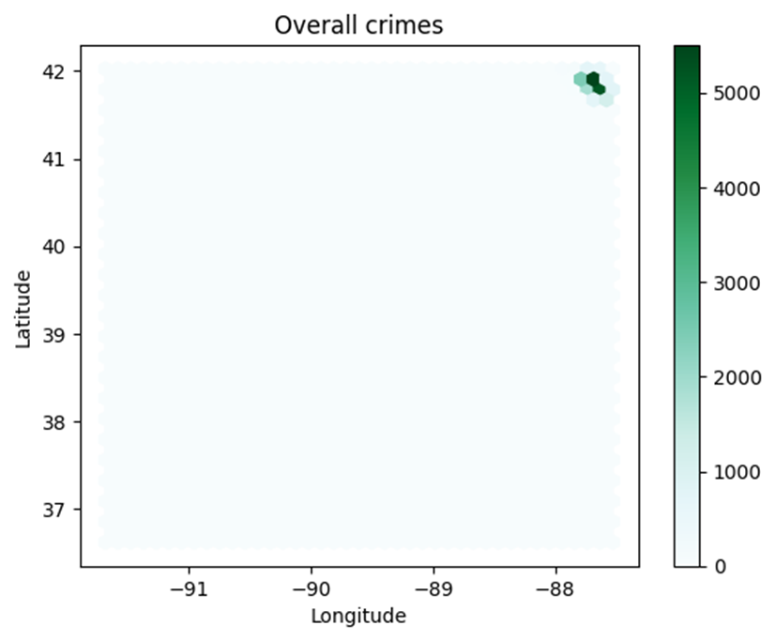
COORDINATES OF CRIMES

Slide 13
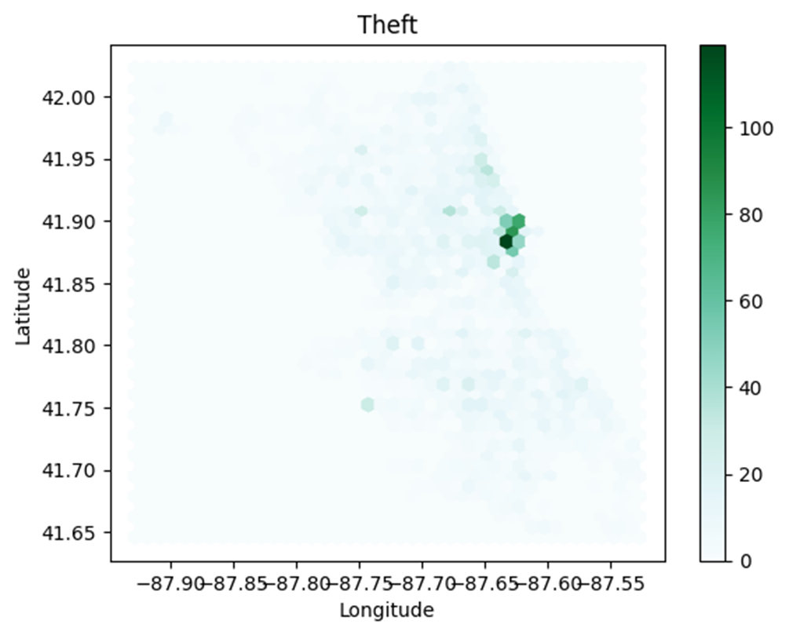
COORDINATES OF THEFT CRIMES

Slide 14
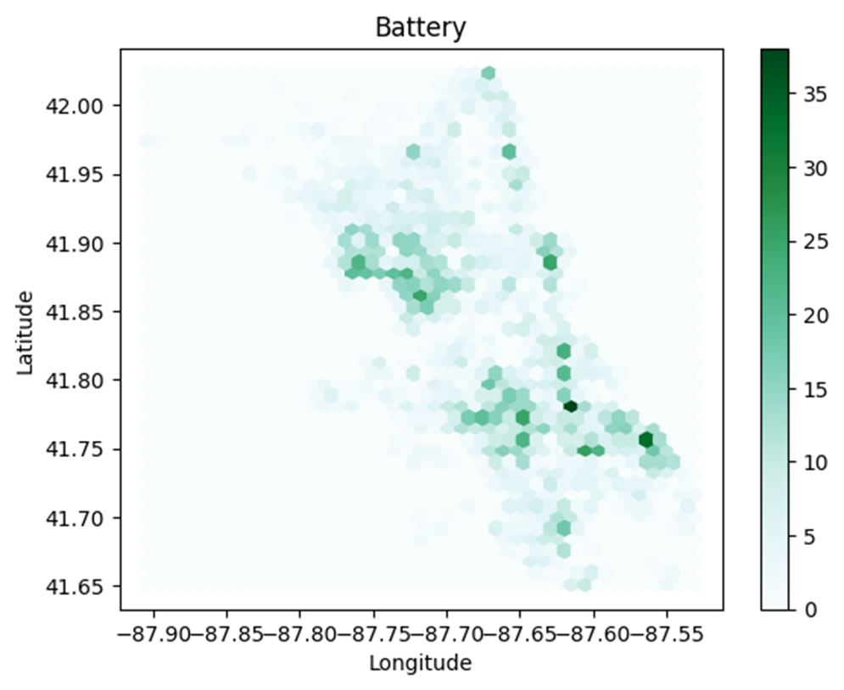
COORDINATES OF BATTERY CRIMES

Slide 15
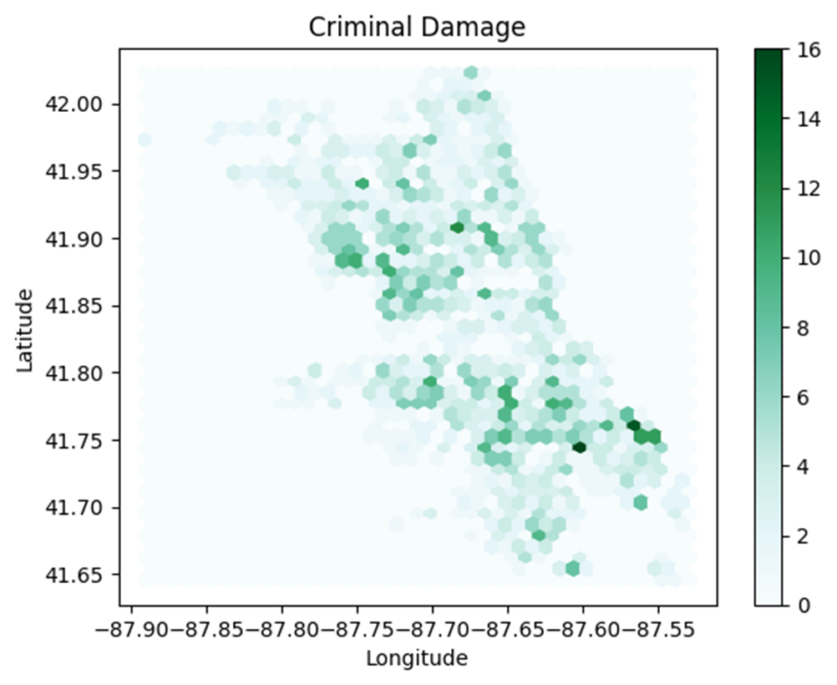
COORDINATES OF CRIMINAL DAMAGE

Slide 16
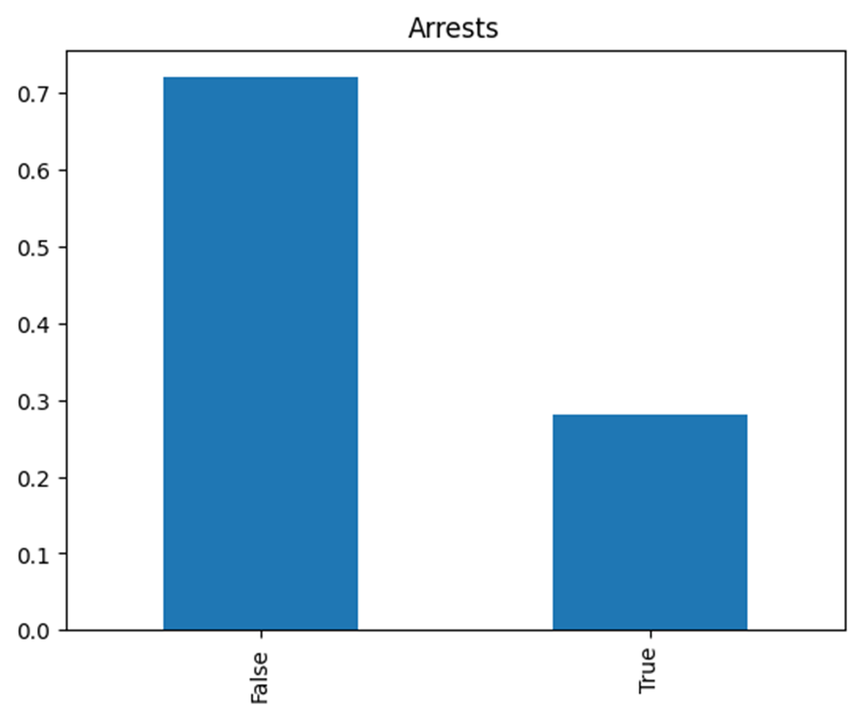
THE ARREST SUCCESS RATE

Slide 17
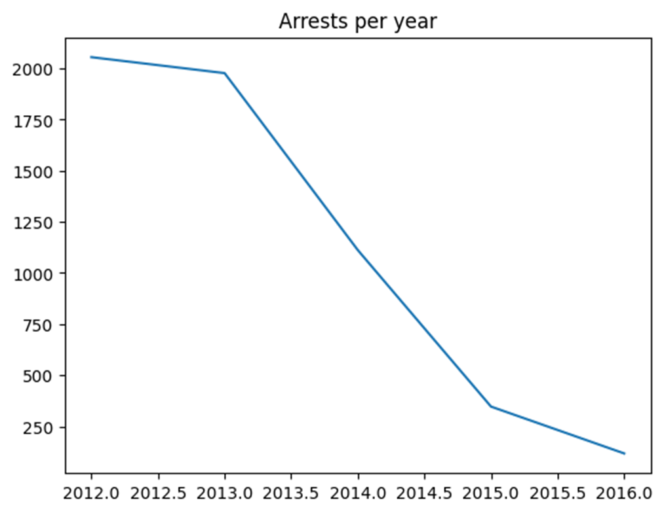
THE ARREST PER YEAR

Slide 18
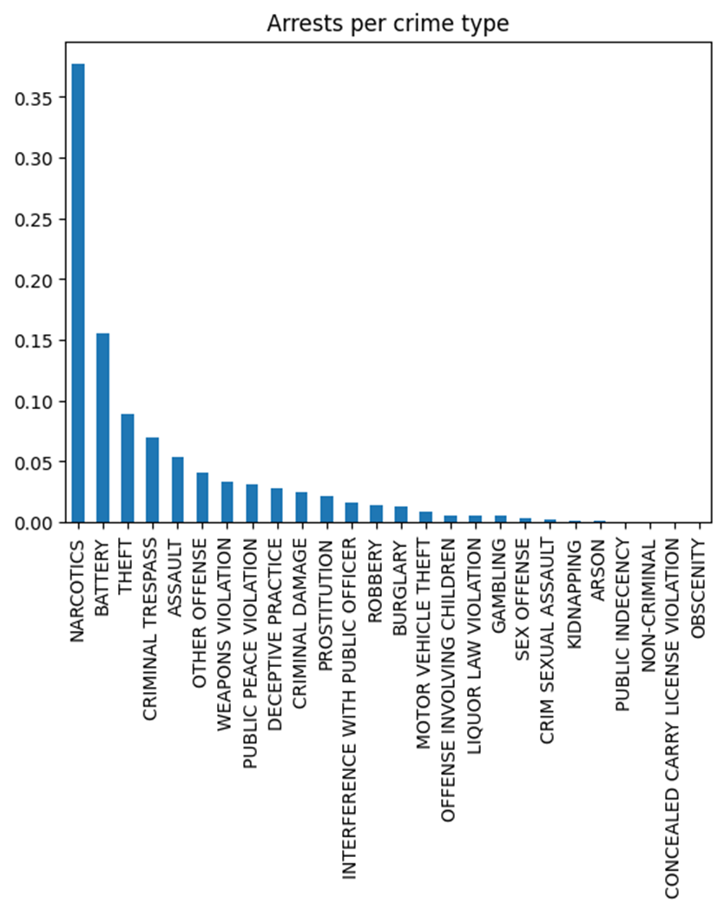
THE ARREST PER CRIME TYPE

Slide 19
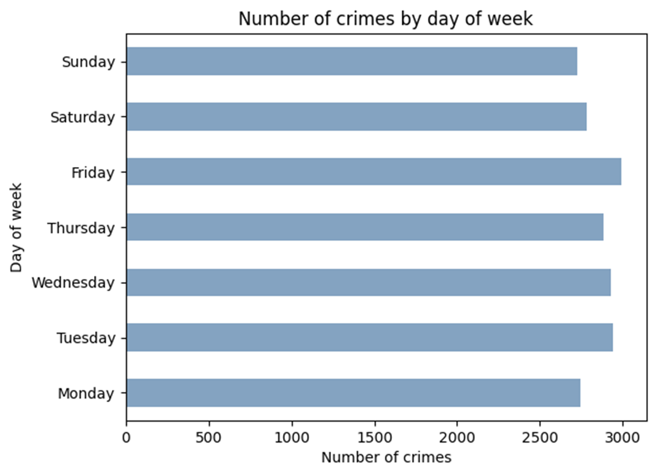
NUMBER OF CRIMES BY DAY OF WEEK

Slide 20
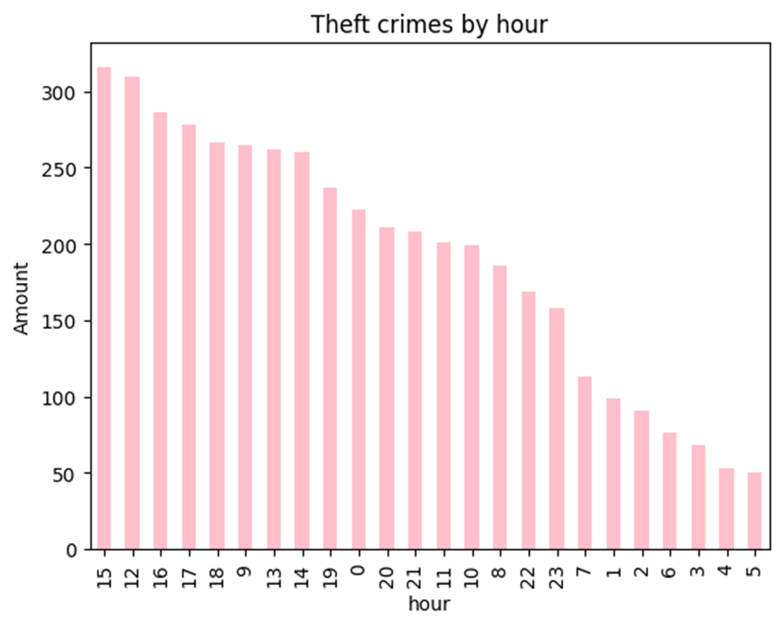
THE THEFT CRIMES BY HOUR

Slide 21




Chapter 3: Data Pre-Processing
Read
Connect
Cleaning
Post-processing

Slide 22

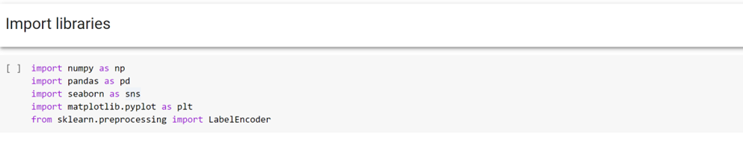
1. Read the dataset

Slide 23
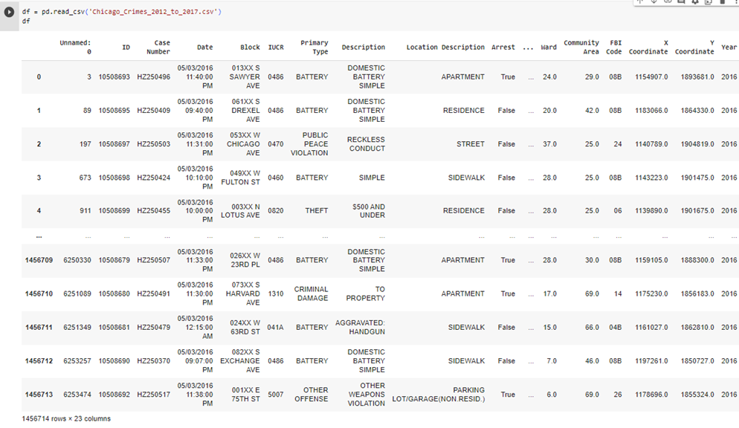
2. Connect the data

Slide 24
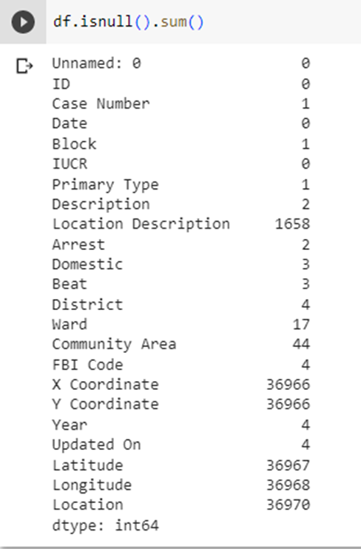
3. Data Cleaning
Check for null values
We have more than 100000 missing values in the dataset. This missing value can cause several issues including lack of sufficient data to perform the analysis.

Slide 25




3. Data Cleaning
Reduce size of data
MORE

Slide 26

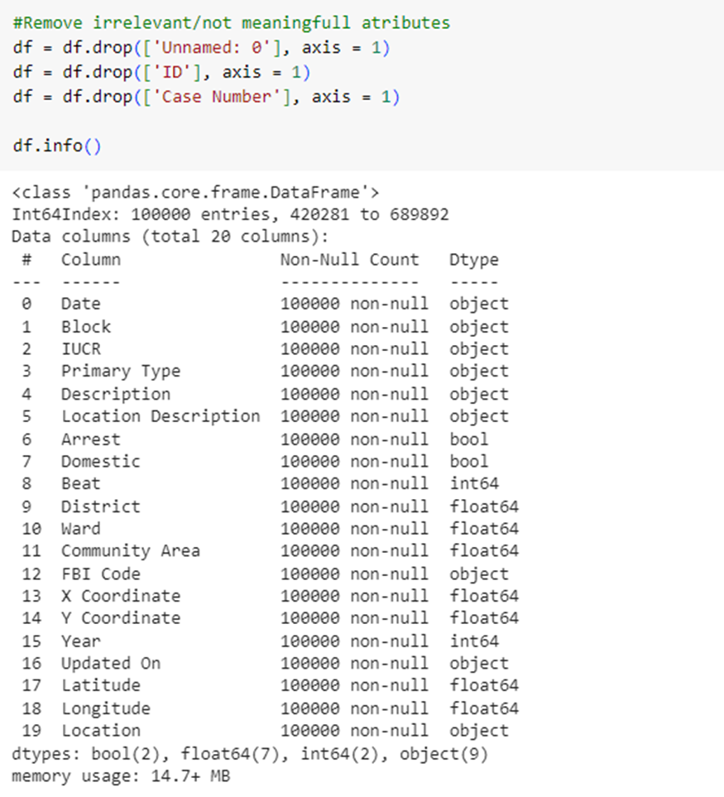
3. Data Cleaning
Delete irrelevant data
MORE

Slide 27
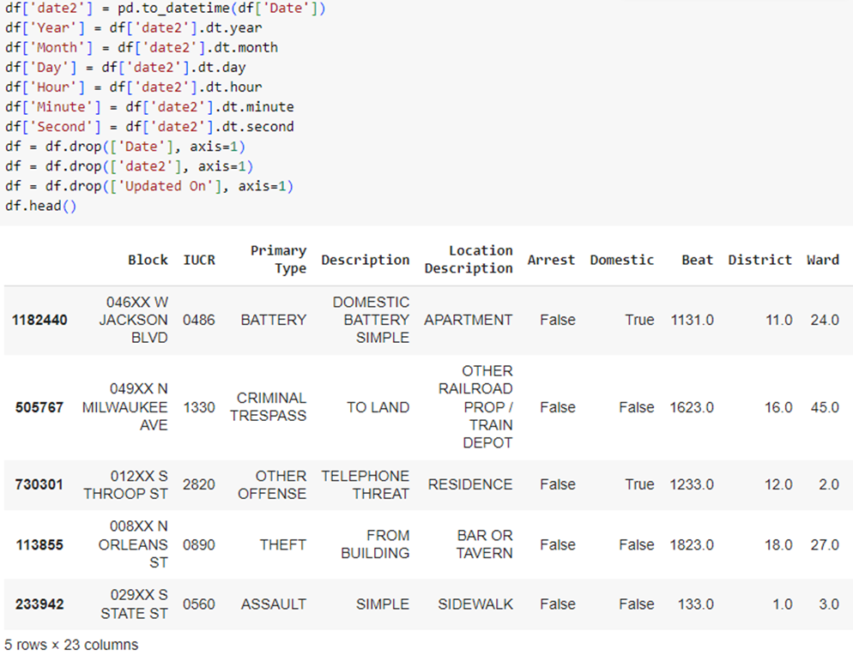
3. Data Cleaning
Split the "Date" attributes into:
MORE

Slide 28
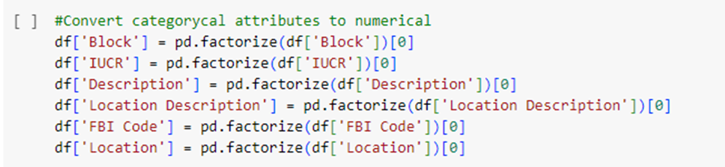
3. Data Cleaning
Convert into numerical type:
MORE

Slide 29
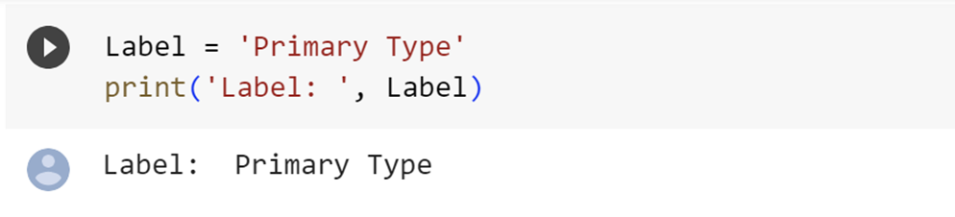
3. Data Cleaning
Identify the output of data
MORE

Slide 30
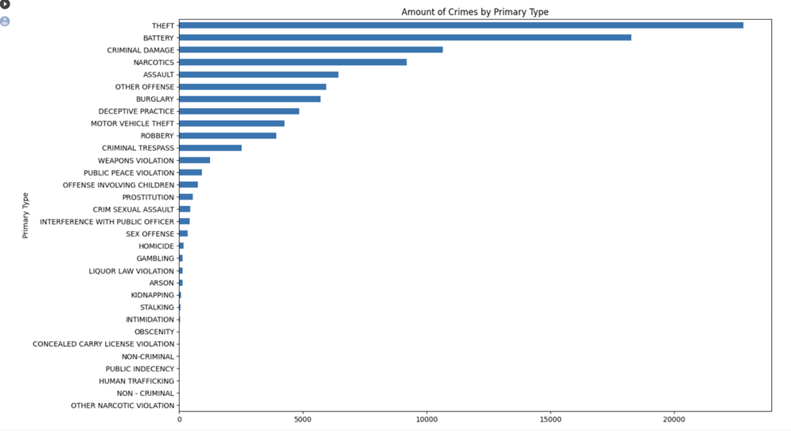
3. Data Cleaning
Overview of attribute values
MORE

Slide 31
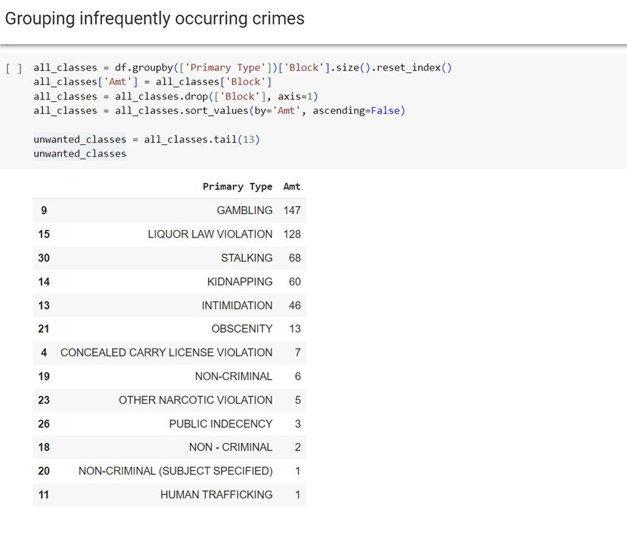
3. Data Cleaning
Grouping infrequently occurring crimes
MORE

Slide 32
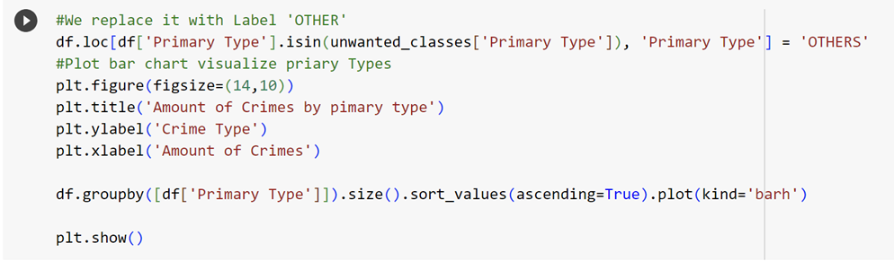
3. Data Cleaning
Replace those 13 classes with label 'Others'
MORE

Slide 33
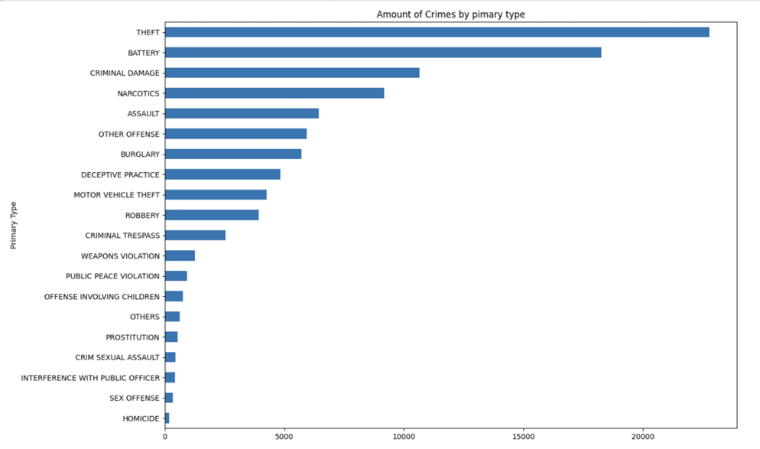
3. Data Cleaning
Replace those 13 classes with label 'Others'
MORE

Slide 34
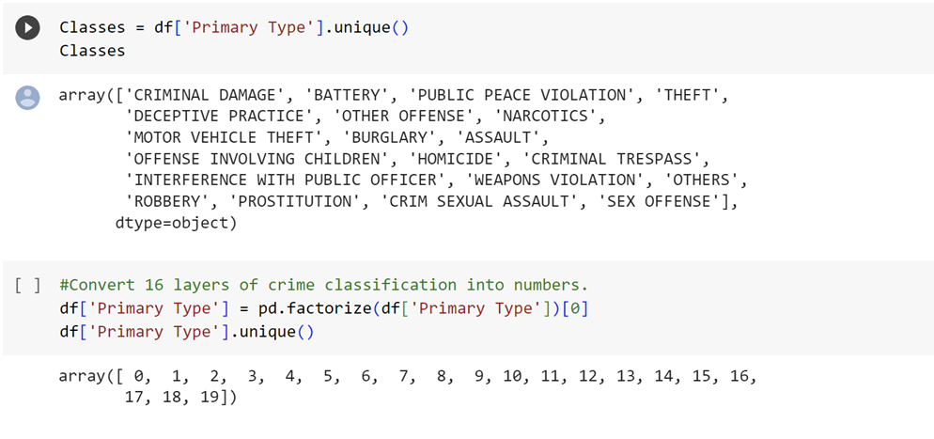
3. Data Cleaning
Convert 16 crime classification classes into numbers
MORE

Slide 35


4. Post Processing Data

Slide 36
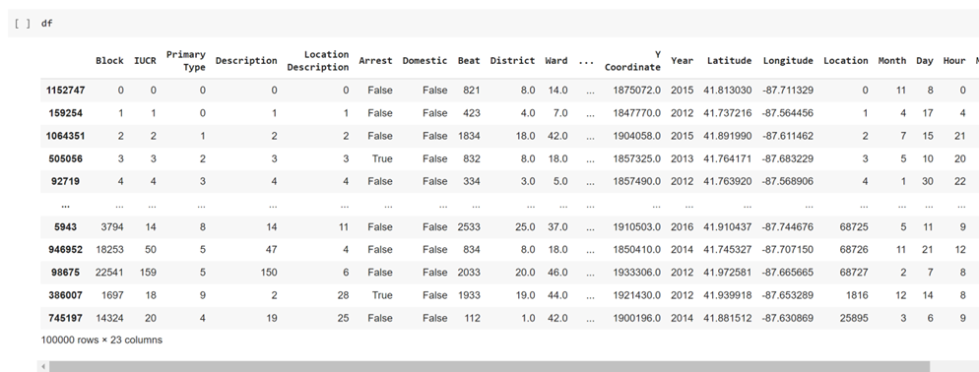
Post Processing Data

Slide 37
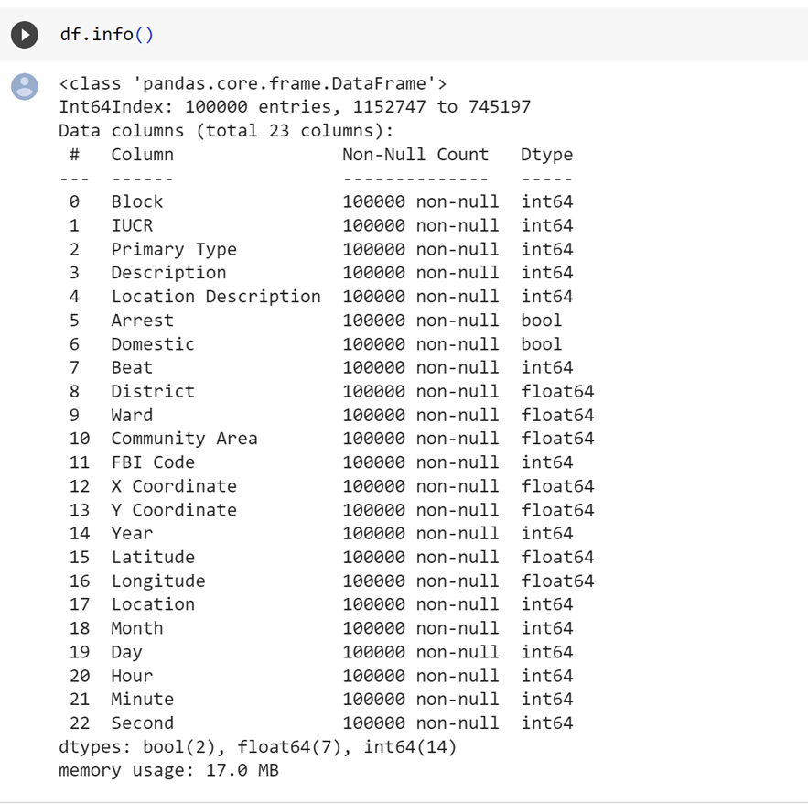
Post Processing Data

Slide 38





CHAPTER 4:
ALGORITHMS APPLIED

Slide 39



ALGORITHMS:
NAIVE BAYES
SVM
DECISION TREE
RANDOM FOREST
LOGISTIC REGRESSION
XGBOOST
KNN

Slide 40




NAIVE BAYES
1
2
3
4
naive bayes
classifier
Assumes feature independence
Popular for text classification
Fast and accurate predictions
Based on Bayes' Theorem with independent predictors.
Features in a class are unrelated to each other.
Widely used for categorizing text.
Leverages feature independence for quick and accurate results.

Slide 41
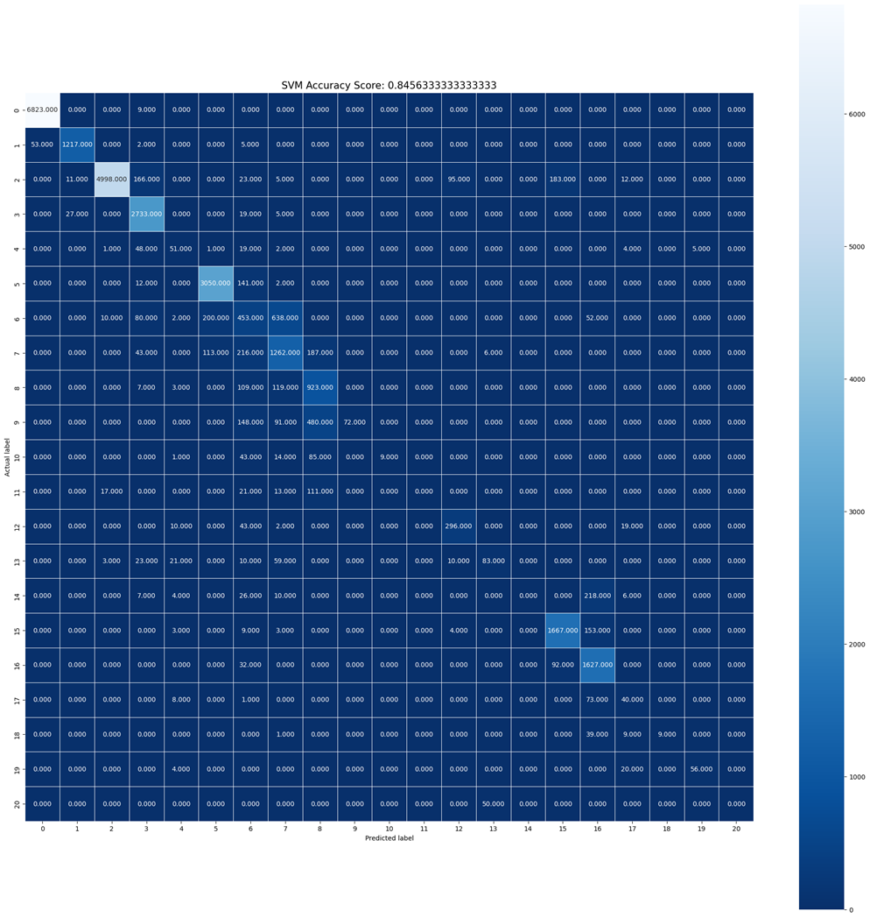

PYTHON IMPLEMENTATION

Slide 42
Support Vector Machine (SVM)
1
2
3
4
SVM
Kernel trick
SVR
Best fit line
Supervised learning algorithm used for classification and regression.
SVM-based approach for predicting discrete values in regression problems.
SVR finds the hyperplane that maximizes the number of points, serving as the regression model.
SVMs can handle non-linear data by mapping it to higher-dimensional feature spaces.

Slide 43
PYTHON IMPLEMENTATION

Slide 44
DECISION TREE
1
2
3
4
Decision Tree
Decision Tree Regression
Tree Structure
Meaningful Output
Flowchart-like tool for decision-making.
Models decisions and outcomes.
Uses tree structure for prediction.
Produces continuous output.
Nodes represent decisions/features.
Branches/leaves represent predictions.
Continuous output with unknown values

Slide 45

PYTHON IMPLEMENTATION

Slide 46
RANDOM FOREST
1
2
3
Random Forest
Random Forest Algorithm
Precision and Number of Trees
Addresses overfitting in linear models.
Reduces complexity and improves accuracy.
Specifically for data with multicollinearity.
Multiple decision trees combined.
Outcome based on tree predictions.
Averages predictions for final result.
More trees improve outcome precision.

Slide 47
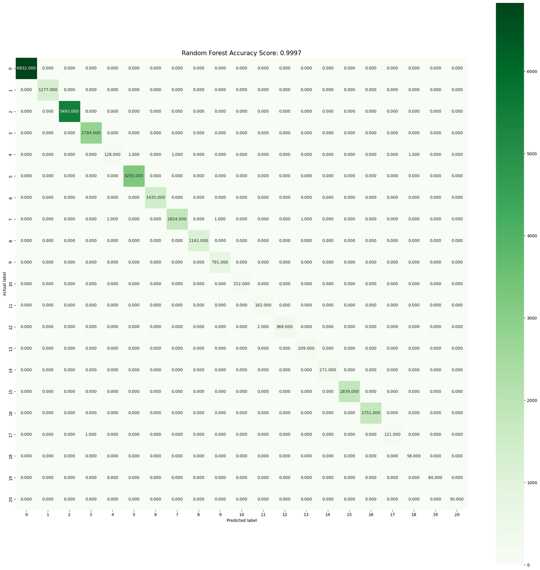
PYTHON IMPLEMENTATION

Slide 48
LOGISTIC REGRESSION
1
2
3
Suitable for various variable types
Focus on relationship
Logistic regression
describe and explain the relationship between a dependent binary variable and independent variables of different scales.
Logistic regression can handle nominal, ordinal, interval, or ratio-level independent variables.
logistic regression helps understand and model the relationship between the dependent variable and the independent variables.

Slide 49
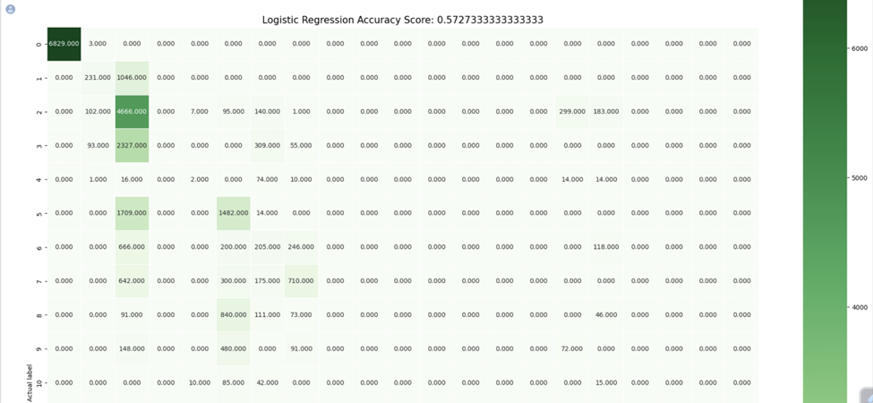
PYTHON IMPLEMENTATION

Slide 50
XGBOOST
1
2
XGBoost
Key Features of XGBoost
"Extreme Gradient Boosting" algorithm.
Handles large datasets, achieves top performance.
Efficiently handles missing values in real-world data.
Built-in support for parallel processing.

Slide 51



PYTHON IMPLEMENTATION

Slide 52
K-NEAREST NEIGHBORS (KNN)
1
2
3
4
Proximity-based approach
Primarily a classification algorithm
Assumption of similarity
KNN
Non-parametric, supervised learning classifier
used for classification or regression tasks.
KNN uses the proximity of data points to make predictions or classifications.
applicable to both regression and classification
commonly used as a classification algorithm.
KNN assumes that similar data points are located near each other in the feature space

Slide 53
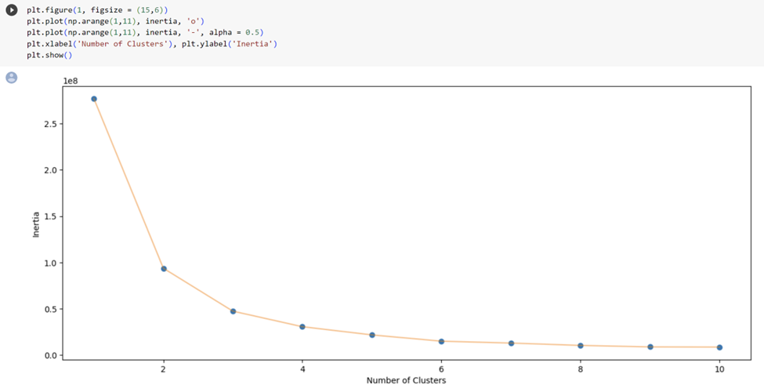
PYTHON IMPLEMENTATION

Slide 54
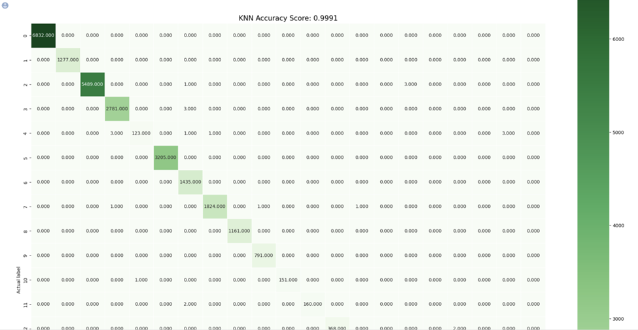
PYTHON IMPLEMENTATION

Slide 55




CHAPTER 05:
ALGORITHMS ANALYSIS AND EVALUTION

Slide 56
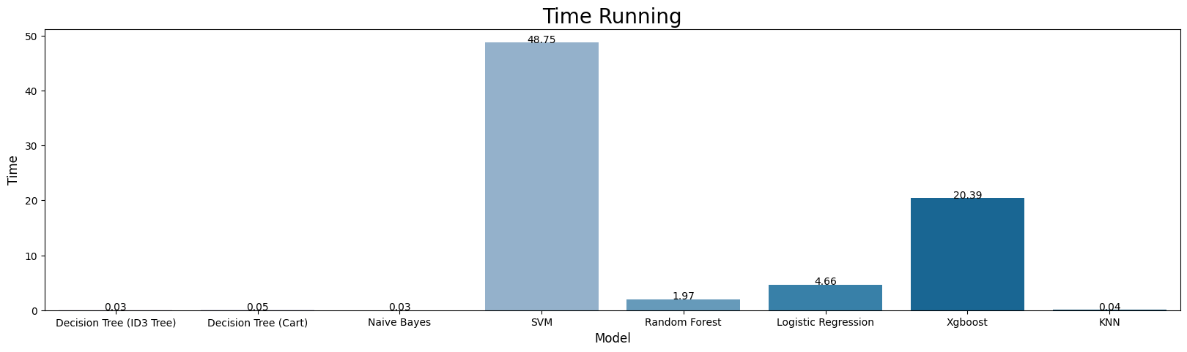
Running time

Slide 57
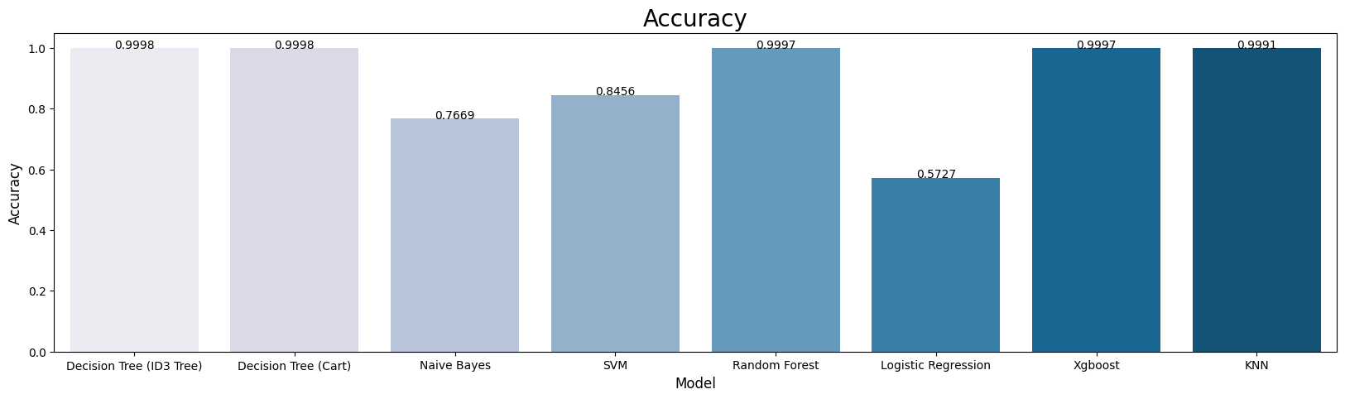
Accuracy

Slide 58
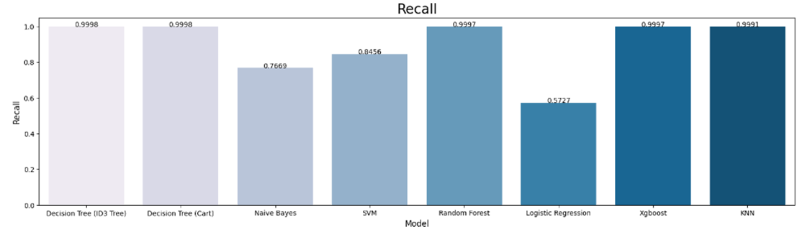
Recall

Slide 59
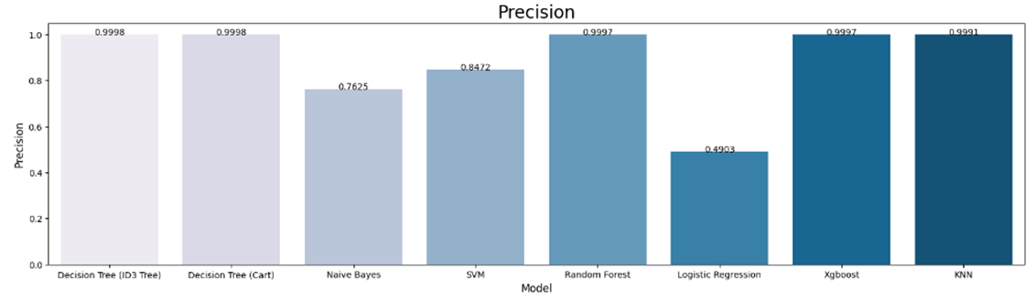
Precision

Slide 60
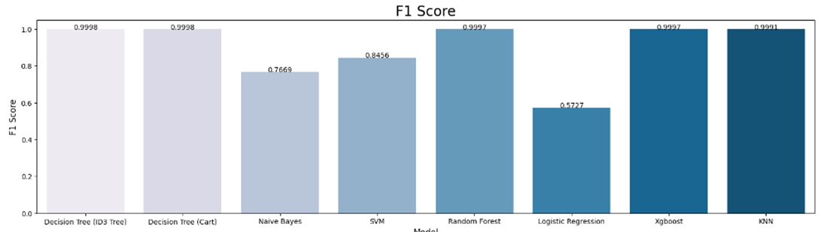
F1 Score

Slide 61


CONCLUSION
The Decision Tree (ID3 Tree), Decision Tree (Cart), Random Forest, and Xgboost algorithms consistently perform well with high accuracy scores.
Therefore, the Decision Tree (ID3 Tree) algorithm is the recommended choice, followed by Decision Tree (Cart), Random Forest, and Xgboost.
The Decision Tree (ID3 Tree) algorithm has the fastest running time.
Check Detail
Check Detail

Slide 62




CONTACT US
UIT - GROUP 6
035 720 3489
20522079@gm.uit.edu.vn

